Slide 1

TEAM SUNSHINE!
Cara, Carson, Brian, Richard

Slide 2
Benefits of solar prediction
At scale, this capability can help utilities plan their demand and consumers to plan their consumption
At the consumer level, this could help consumers keep their daytime usage within their generation capacity – important during peak times in the new net metering program from SDGE.

Slide 3
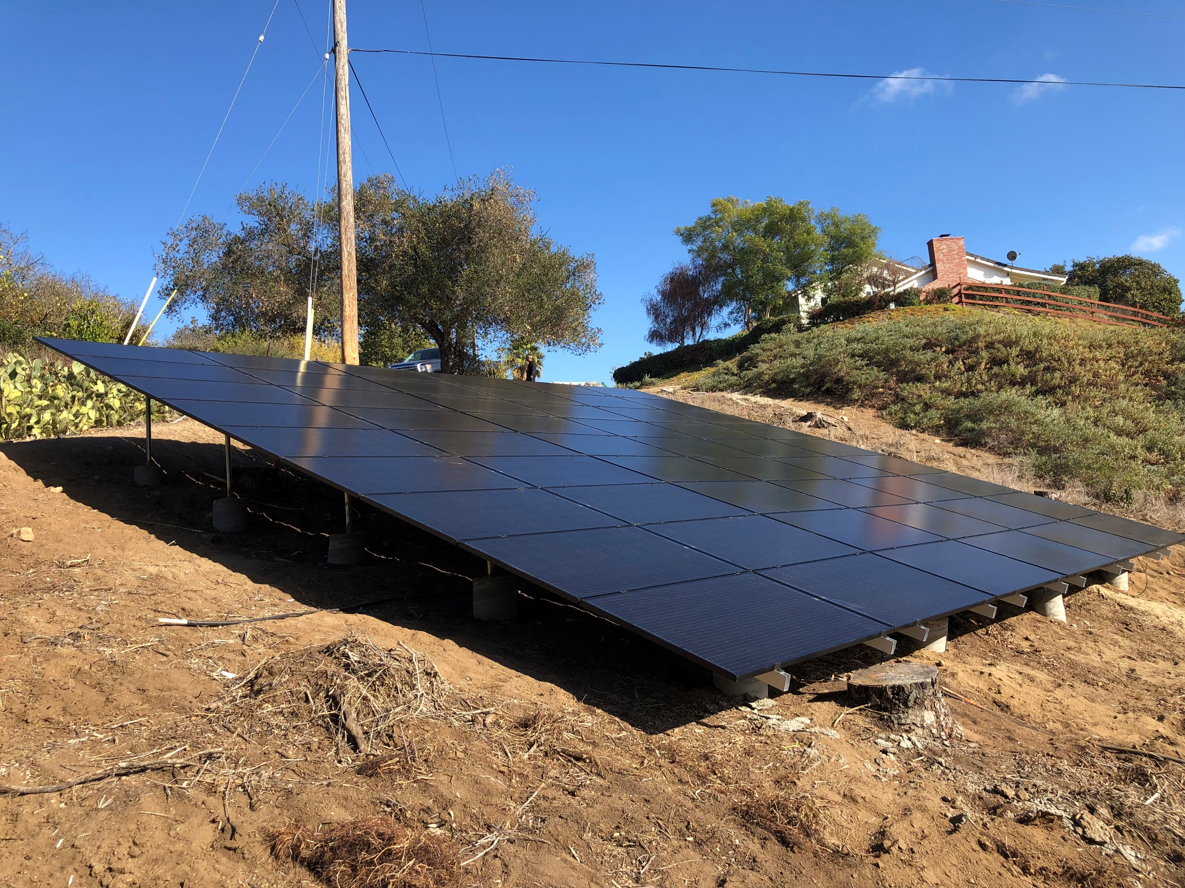
Data Sources
Solar Edge API
Provides power generation data
Weather API
Provides historical data and forecasts

Slide 4
Ui demo
Switch to browser

Slide 5
How we developed it
Divided the work by technology
UI : Brian
Prediction : Carson
Weather data interface : Cara
Solar data interface : Richard
Weather and Solar modules included callbacks for UI and Prediction to use to populate elements

Slide 6
Weather api

Slide 7
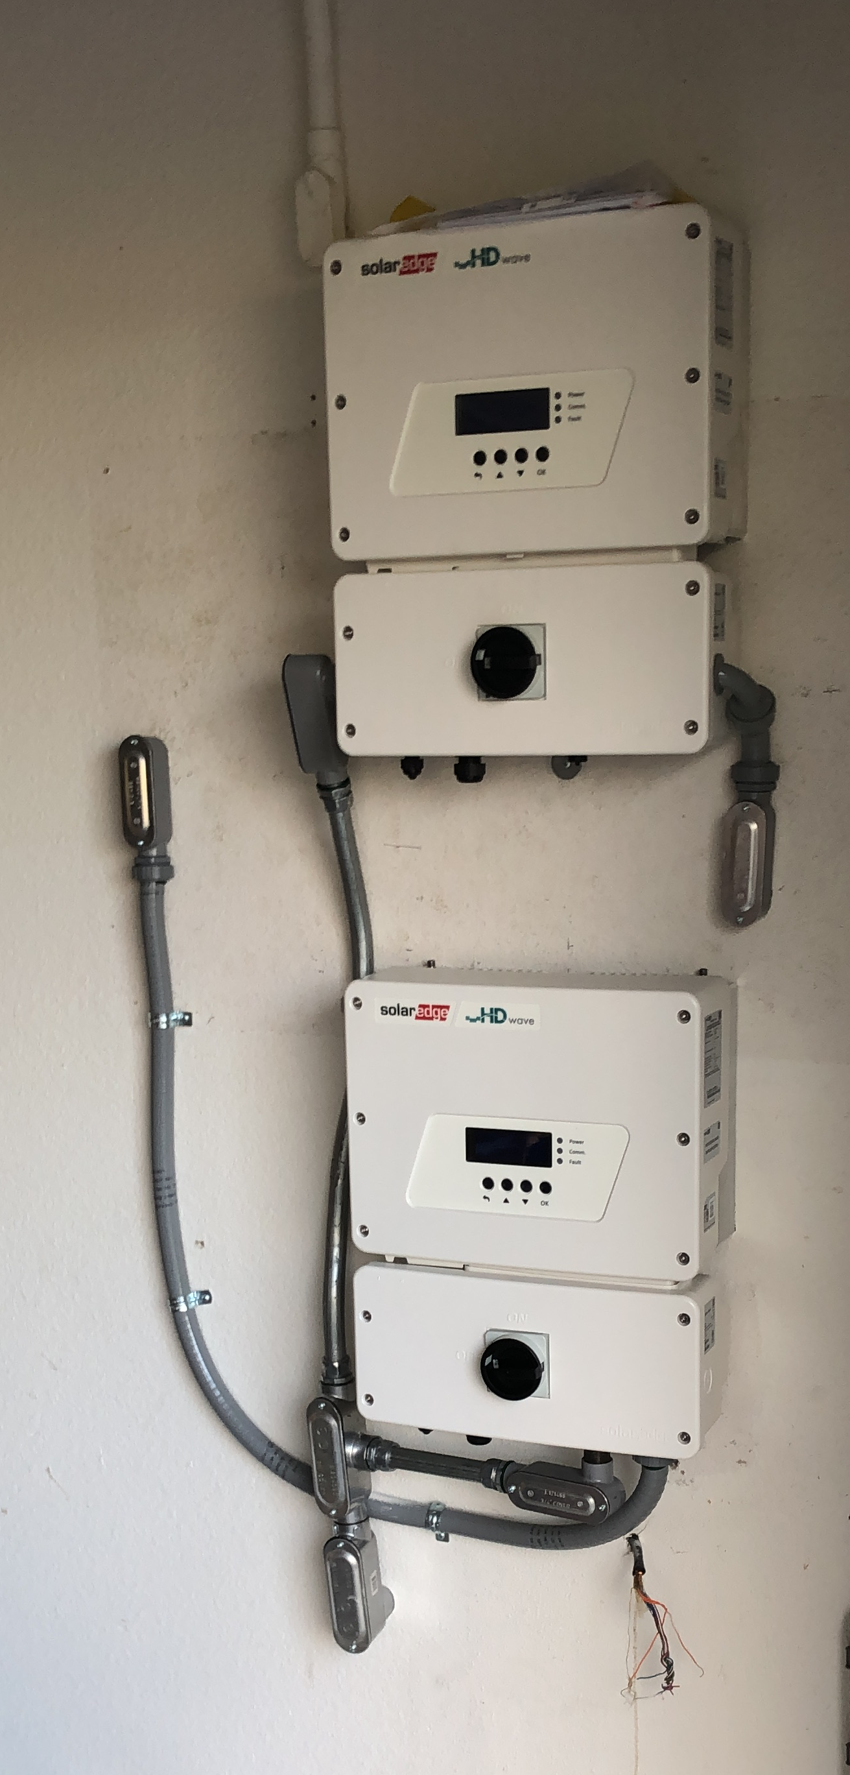
Power generation api
Solar Edge API
The Inverters are connected to the internet and update a cloud service every 15 minutes
API key was issued by Solar Edge to access data generated by these inverters
Using two APIs from Solar Edge:
Get site information (physical address of array)
Get site power generation history
Our interface module defines two Javascript functions:
function getSiteInfo(siteID, callback);
function getProductionHistory(siteID, startDateUnix, endDateUnix , callback)
Callback passes back a results object array

Slide 8
Prediction algorithm

Slide 9
New technologies used
SolarEdge API
Weather API – Darksky.net
Google Charts

Slide 10
What we would do differently

